Slide 1
Utilizing Software for Business Process Modeling
Software picked: Lucidchart
Presenter: Aleksander Muszyński

Slide 2
Specification of functionalities (1/2)
Spec. Name | Input(s) | Output(s) | Description | Significance
Diagram Creation and Editing | User inputs (keyboard, mouse) | Business process diagram visible on-screen | The program must allow for creating and editing business process diagrams. | Must have
Save and Load Functionality | For saving: user inputs For loading: diagram file | For saving: diagram file, For loading: editable display of diagram | Users must be able to save their work as diagram files and load it in future sessions | Must have
Version History | Diagram file | A display of all or select previous states of this diagram file | Users should be able to view, compare, and/or restore previous versions of the opened diagram file inside the software | Should have
Collaboration Features | Joint session setup settings (ex. collaborator usernames, session host link, etc.) | Working online session | Users should be able to host and join online sessions, letting them all edit the same diagram at the same time. | Should have
Free Tier | User credentials | Free access to the software | The program should offer a free tier for users trying it out | Should have
Browser Version | Web address | Editor opened in browser | The program could have a browser version, allowing usage without installation | Could have
Diagram Templates | Template name | Pre-made diagram template | The program could offer diagram templates for common procedures | Could have
AI Integration | Prompts | Automatic diagram alteration | The program could offer AI features that edit the diagram based on user commands | Could have

Slide 3
Specification of functionalities (2/2)
Spec. Name | Significance | SAP Signavio | IBM Blueworks Live | ADONIS | Microsoft Power Automate | Bizagi | Lucidchart
Diagram Creation and Editing | Must have | Yes | Yes | Yes | Yes | Yes | Yes
Save and Load Functionality | Must have | Yes | Yes | Yes | Yes | Yes | Yes
Version History | Should have | Yes | Yes | Yes | Yes | Yes | Yes
Collaboration Features | Should have | Yes | Yes | Yes | Yes | Yes | Yes
Free Tier | Should have | Free trial | Free trial | Yes | Free trial | Yes | Yes
Browser Version | Could have | Yes | Yes | Yes | Yes | Yes | Yes
Diagram Templates | Could have | Yes | Yes | Yes | Yes | Yes | Yes
AI Integration | Could have | Yes | In development | Yes | Yes | No | Yes
For this lab’s exercises I chose Lucidchart, because:
It has a free tier (up to 3 diagrams) without time constraints
It’s available in the browser
It’s (subjectively) quick and easy to pick up
Some of us already know it from previous semesters (and don’t need to make accounts)

Slide 4
Comparative price analysis
Name | SAP Signavio | IBM Blueworks Live | ADONIS | Microsoft Power Automate | Bizagi | Lucidchart
Web/Standalone | Web | Web | Web | Both | Both | Web
Producer/Provider | SAP | IBM | BOC Group | Microsoft | Bizagi
Price (base tier) | “Contact us for pricing” (read: “HIGH”) | 66.14 euro/month | 99 euro/month | 13 euro/month | “Contact us for pricing” (read: “HIGH”) | Not shown on website (from unofficial sources: $7.95)
Free tier limitations | No “free tier”, only a 30-day trial period, intended for evalutation. | Max. 30 days | No time limit, no advanced features | Free tier with no time limit OR 90-day free trial of full software | No time limit, no advanced features | No time limit, no advanced features, max. 3 diagrams
Lucidchart base tier price source: https://revpilots.com/pricing/lucidchart-pricing/

Slide 5
Exercises - Prerequisites
1. Go to Lucidchart.com
2. Create an account / sign into an existing account
3. Create a new blank diagram and open it.

Slide 6
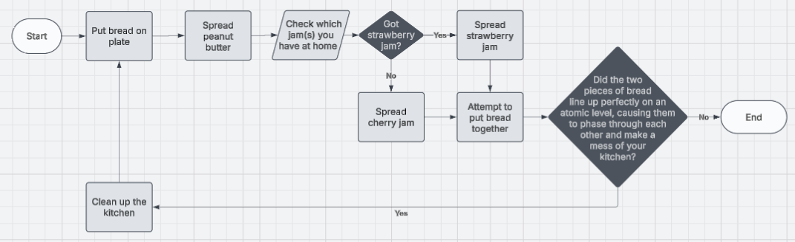
Exercises - Example
Create a flowchart depicting the process of making a peanut butter jelly sandwich:
  Put two pieces of bread on a plate
  Smear one piece of bread with peanut butter
  If you have strawberry jam, smear other piece of bread with strawberry jam. Otherwise, use cherry jam.
  Attempt to put the two bread pieces together. If the atoms in both pieces of bread line up perfectly and the two pieces phase through each other, clean up the mess and repeat the process. If not, end the process.

Slide 7
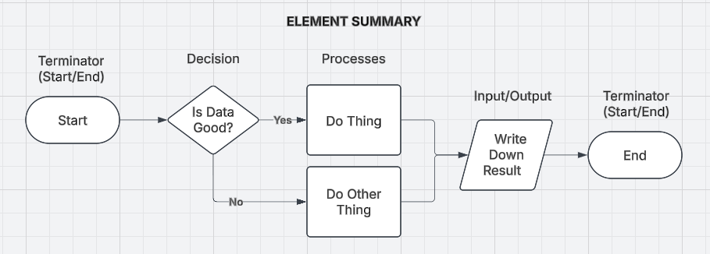
Exercises - Tasks
1. Create a flowchart broadly describing your morning routine. This flowchart should include steps such as: picking your outfit, choosing what to eat for breakfast based on mood or available ingredients, and pressing the snooze button on your alarm repeatedly until some vague criteria becomes true and you decide that “enough is enough, it’s time to get up.”
2. Create a flowchart describing the steps you need to take to brew a cup of tea for someone. Take into account whether or not that person likes sugar in their tea.
3. Someone has been murdered and is lying dead in front of you. Create a flowchart to describe your decisionmaking process, based on 4+ factors such as: Are you safe? Are you in public? Do you have a phone to call the police with? Do they have any money left in their wallet? How badly do you need cash? Is there anywhere nearby to hide the body? Are you the murderer?
Remember to screenshot your tasks’ results, put them in the report, and deliver the reports next week!
Report rules are on the course PDF on eportal!

